Slide 1
SOFTWARE ENGINEERING

Slide 2
Definition of Software
Instructions (computer programs) that when executed provide desired features, functions and performance
Data Structures that enable the programs to adequately manipulate information
Documents that describe the operation and use of a program

Slide 3
EXAMPLES OF SOFTWARE
Systems Software
Real-time Software
Engineering and Scientific Software
Embedded Software
Artificial Intelligence Software

Slide 4
Systems Software
Group of programs written to service other programs. E.g
Compiler
Editors
Operating System
Drivers
Communication Processors

Slide 5
Real-time Software
Programs that monitor/analyze/control real world events as they take place are called real-time software. It has
A data gathering component that collects and formats information from an external environment
An analysis component that transforms information as required by the application
A control/output component that respond to the external environment
A monitoring component that coordinates all other components so that real-time responds can be maintained
E.g Air Traffic Control Systems, Networked Multimedia Systems, Command Control Systems etc

Slide 6
Engineering and Scientific Software
Characterized by “number crunching” algorithms
Applications include: oceanography, astronomy, chemical analysis, spacecraft dynamics, particle acceleration, auto card
New applications ; CAD, simulation have begun to take on real-time and even system software characteristics

Slide 7
Embedded Software
Intelligent products are now common in almost every consumer electronic and in the industrial market
They reside in read-only memory and are used to control products and system for the consumer electronics
Perform very limited and esoteric functions(e.g key pad control for a microwave oven) or provide significant functions and control capability (e.g digital functions in a TV set etc)

Slide 8
Artificial Intelligence Software
Makes use of non-numerical algorithms to solve complex problems that are not amenable to computation or straight forward analysis e.g. Expert System, Knowledge Base System, pattern recognition (image, voice), theorem proving, game playing.
A new branch of AI software called artificial neural networks is in vogue. A neural network simulates the structure of brain processes and may ultimately lead to a new class of software that can recognize complex patterns and learn from past experiences

Slide 9
Some Basic Terms
Client: An individual or organization who wants a product to be developed
Developers: Are the members of the organization responsible for building the product. The developers may be responsible for every aspect of the development process, from the beginning of the requirements phase until the product passes acceptance test.

Slide 10
Some Basic Terms – cont’d
Developers may be responsible for only the implementation of an already designed product
User: the user is the person or persons on whose behalf the client has commissioned the product and who will utilize the software

Slide 11
SOFWARE DEVELOPMENT
The term software development covers all aspects of software production before the product enters the maintenance phase.
Any task that is a step towards building a piece of software, including specifying, planning, designing, testing, or documenting, constitute software development.

Slide 12
SOFTWARE PROCESS
The way software is produced
It incorporates the software life-cycle model, the tool used and most important of all, the individuals building the software
Different Organizations have different software processes.

Slide 13
SOFTWARE PROCESS – cont’d
The steps through which the product progresses
  1. Requirements phase
  The concept is explored and refined, and the client’s requirement are elicited
  2 .Specification (Analysis) phase
  The client’s requirements are analyzed and presented in the form of the specification document, “What the product is supposed to do.”

Slide 14
SOFTWARE PROCESS – cont’d
  3. Design phase
  The specifications undergoes two consecutive design process.
    First comes the architectural design in which the product as a whole is broken down into components called modules.
    Then each module in turn is designed; this process is termed detailed design. The two resulting design documents describe “how the product does it”
  4 Implementation phase
  The various components are coded and tested

Slide 15
SOFTWARE PROCESS – cont’d
  5. Integration phase
  The components of the product are combined and tested as a whole. This phase ends when the product is accepted by the client and goes into operations mode
  6. Maintenance phase
  Includes all changes to the product once the client has agreed that it satisfies the specification document. Maintenance includes corrective maintenance (or software repair) which consist of the removal of residual faults while leaving the specification unchanged

Slide 16
Maintenance Phase – cont’d
And Enhancement (or software update) which consists of changes to the specifications and the implementation of those changes. There are two types of enhancement
Perfective(improve the effectiveness of the product) - such as additional functionality, decrease response time
Adaptive (changes made in response to environment where the software operate) such as government regulations, VAT

Slide 17
Retirement Phase
The goal of the Retirement Phase is the removal of a software release from production, it is also known as system decommissioning or system sunsetting.
The retirement of systems is a serious issue faced by many enterprises today as legacy systems are removed and replaced by new systems.

Slide 18
Testing Phase ?
There is NO testing phase
Testing is an activity performed throughout software production
Verification
  Performed at the end of each phase
Validation
  Performed before delivering the product to the client

Slide 19
Documentation Phase?
There is NO documentation phase
Every phase must be fully documented before starting the next phase
  Postponed documentation may never be completed
  The responsible individual may leave
  The product is constantly changing—we need the documentation to do this
  The design (for example) will be modified during development, but the original designers may not be available to document it

Slide 20
Requirements Phase
Assumption
  The software being considered is economically justifiable
Concept exploration
  Determine what the client needs, not what the client wants
Testing
  Rapid prototyping
Documentation
  Rapid prototype, or
  Requirements document

Slide 21
Specification Phase
Specifications document (“specifications”)
  Legal document
  Must not have phrases like “optimal,” or “98% complete”
Specifications must not be
  Ambiguous
  Incomplete
  Contradictory
Once the specifications have been signed off
  The software product management plan (SPMP) is drawn up
  This is the earliest possible time for the SPMP

Slide 22
Specification Phase (cont)
Testing
  Traceability
  Review
  Check the SPMP
Documentation
  Specification document (specifications)
  SPMP

Slide 23
Design Phase
Specification—what
Design—how
Retain design decisions
  When a dead-end is reached
  For the maintenance team
  Ideally, the design should be open-ended
Architectural design
  Decompose the product into modules
Detailed design
  Design each module: data structures, algorithms

Slide 24
Design Phase (cont)
Testing
  Traceability
  Review
Documentation
  Design
    Architectural design
    Detailed design

Slide 25
Implementation Phase
Implement the detailed design in code
Testing
  Review
  Test cases
    Informal testing (desk checking)
    Formal testing (SQA)
Documentation
  Source code
    Test cases (with expected output)

Slide 26
Integration Phase
Combine the modules and check the product as a whole
Testing
  Product testing
  Acceptance testing
Documentation
  Commented source code
  Test cases for the product as a whole

Slide 27
Maintenance Phase
Maintenance
  Any change once the client has accepted the software
The most money is devoted to this phase
The problem of lack of documentation
Testing
  Regression testing
Documentation
  Record of all changes made, with reasons
  Regression test cases

Slide 28
Retirement
Good software is maintained
Sometimes software is rewritten from scratch
  Software is now unmaintainable because
    A drastic change in design has occurred
    The product must be implemented on a totally new hardware/operating system
    Documentation is missing or inaccurate
    Hardware is to be changed—it may be cheaper to rewrite the software from scratch than to modify it
True retirement is a rare event

Slide 29
Improving the Software Process (cont)
U.S. Department of Defense initiative
Software Engineering Institute (SEI)
The fundamental problem with software
  The software process is badly managed
Software process improvement initiatives
  Capability maturity model (CMM)
  ISO 9000-series
  ISO/IEC 15504

Slide 30
Software Life-Cycle Models
Software Life-Cycle Models include :
  Build-and-fix model
  Waterfall model
  Rapid prototyping model
  Incremental model
  eXtreme Programming
  Synchronize-and-stabilize model
  Spiral model
  Object-oriented life-cycle models
  Comparison of life-cycle models

Slide 31
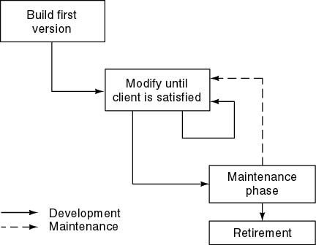
Build and Fix Model
Problems
  No specifications
  No design
Totally unsatisfactory
Need life-cycle model
  Phases

Slide 32
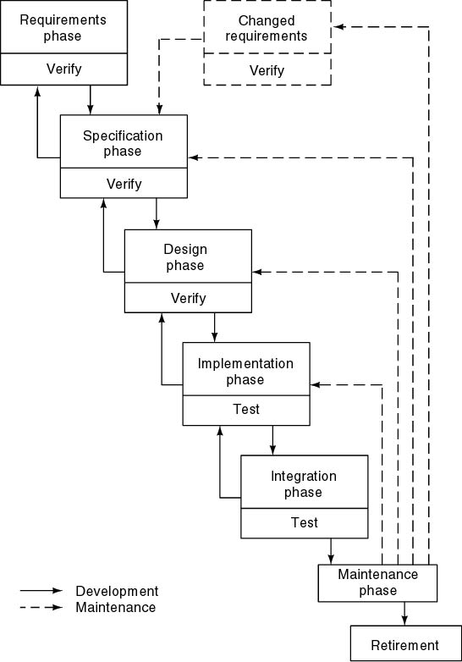
Waterfall Model
Characterized by
  Feedback loops
  Documentation-driven
Advantages
  Documentation
  Maintenance easier
Disadvantages
  Specifications
    Joe and Jane Johnson
    Mark Marberry
Notes:
See chapter 3.2
The fact that the waterfall model is documentation-driven can also be a disadvantage. To see this, consider the following two somewhat bizarre scenarios.
First, Joe and Jane Johnson decide to build a house. They consult with an architect. Instead of showing them sketches, plans, and perhaps a model, the architect gives them a 20-page single-spaced typed document describing the house in highly technical terms. Despite the fact that neither Joe nor Jane have any previous architectural experience and hardly understand the document, they enthusiastically sign it and say “Go right ahead, build the house!”
Another scenario is as follows. Mark Marberry buys his suite by mail order. Instead of mailing him pictures of their suits and samples of available cloths, the company sends Mark a written description of the cut and cloth of their products. Mark then orders a suit solely on the basis of a written description.
The preceding two scenarios are highly unlikely. Nevertheless, they typify precisely the way software is often constructed using the waterfall model.

Slide 33
Prototypes / Proof of concepts
These may be developed to clarify the vision, or to validate technical ideas.
Inception phase prototypes are throw away prototypes, not evolutionary prototype that may be evolved into a product.
  UI oriented prototypes and programming experiments for “show stopper” technıcal questions.
  They are often done with a prototyping tool.
Dr. Kivanc Dincer
CS319 Week 1 - Sept.12,2005

Slide 34
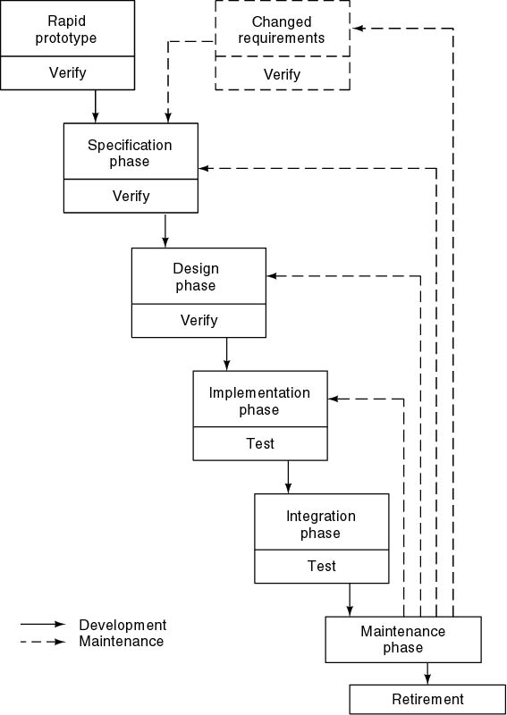
Rapid Prototyping Model
Linear model
“Rapid”
Notes:
No other comments are necessary

Slide 35
Rapid Prototyping Model (cont)
Three Key Points
  Do not turn into product
  Rapid prototyping may replace specification phase—never the design phase
  Comparison:
    Waterfall model—try to get it right first time
    Rapid prototyping—frequent change, then discard
Notes:
No other comments are necessary

Slide 36
Comparison between
Waterfall and Rapid Prototyping Models
Waterfall model
  Many successes
  Client needs
Rapid prototyping model
  Not proved
  Has own problems
Solution
  Rapid prototyping for requirements phase
  Waterfall for rest of life cycle
Notes:
No other comments are necessary

Slide 37
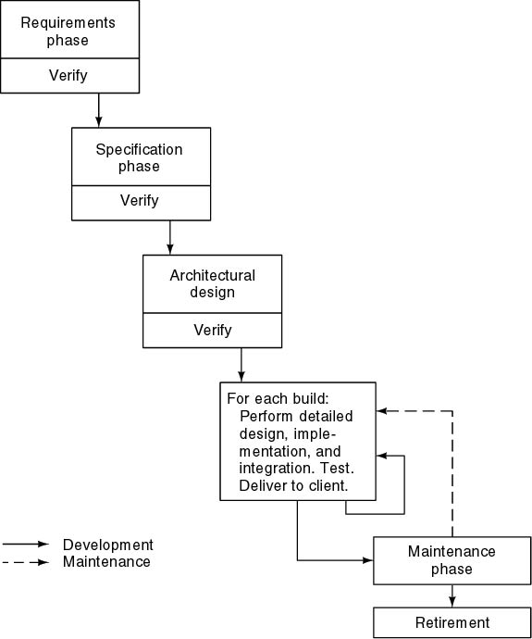
Incremental Model
Divide project into builds

Slide 38
Incremental Model (cont)
Waterfall, rapid prototyping models
  Operational quality complete product at end
Incremental model
  Operational quality portion of product within weeks
Less traumatic
Smaller capital outlay, rapid return on investment
Need open architecture—maintenance implications
Variations used in object-oriented life cycle

Slide 39
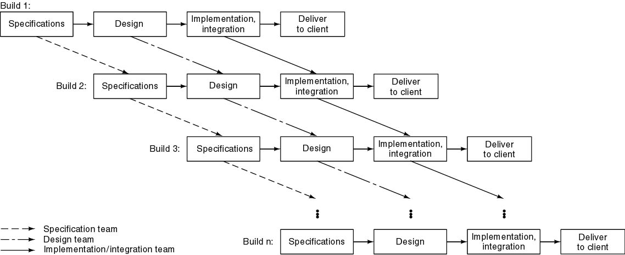
Incremental Model (cont)
Problems
  Build-and-fix danger
  Contradiction in terms
More risky version—pieces may not fit
Notes:
CABTAB and its dangers

Slide 40
Synchronize-and Stabilize Model
Microsoft’s life-cycle model
Requirements analysis—interview potential customers
Draw up specifications
Divide project into 3 or 4 builds
Each build is carried out by small teams working in parallel
At the end of the day—synchronize (test and debug)
At the end of the build—stabilize (freeze build)
Components always work together
  Get early insights into operation of product

Slide 41
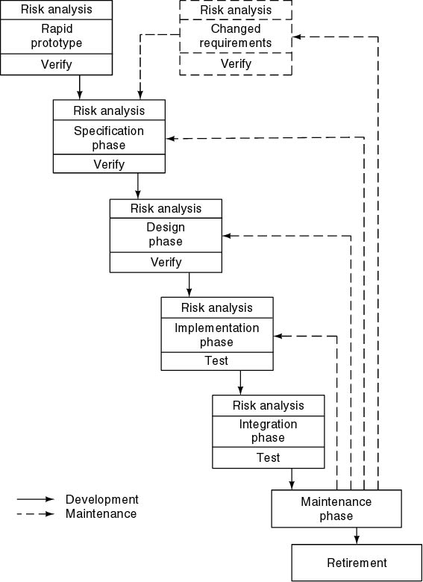
Spiral Model
Simplified form
  Waterfall model plus risk analysis
Precede each phase by
  Alternatives
  Risk analysis
Follow each phase by
  Evaluation
  Planning of next phase

Slide 42
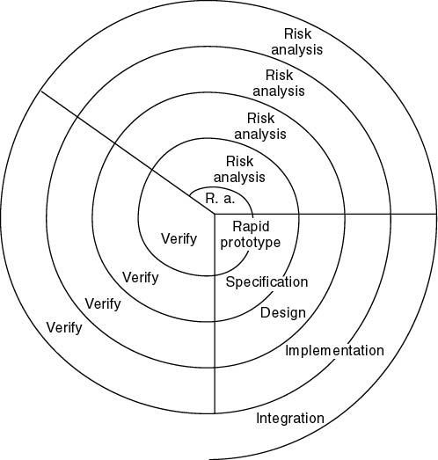
Simplified Spiral Model
If risks cannot be resolved, project is immediately terminated

Slide 43
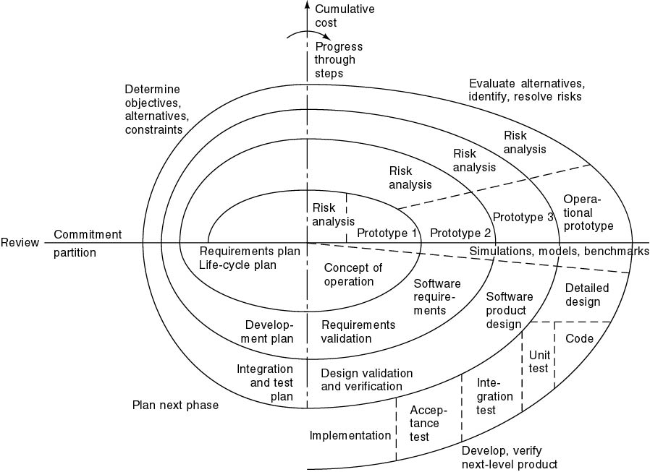
Full Spiral Model
Radial dimension: cumulative cost to date
Angular dimension: progress through the spiral

Slide 44
Analysis of Spiral Model
Strengths
  Easy to judge how much to test
  No distinction between development, maintenance
Weaknesses
  For large-scale software only
  For internal (in-house) software only

Slide 45
Object-Oriented Life-Cycle Models
Need for iteration within and between phases
  Fountain model
  Recursive/parallel life cycle
  Unified software development process
All incorporate some form of
  Iteration
  Parallelism
  Incremental development
Notes:
CABTAB

Slide 46
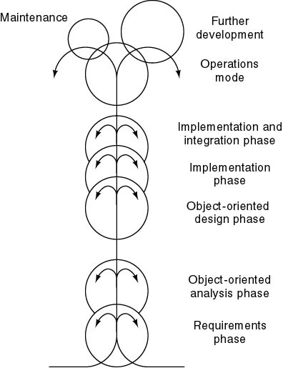
Fountain Model
Features
Overlap (parallelism)
Arrows (iteration)
Smaller maintenance circle

Slide 47
Agile Process
By Kent Beck, 2001
Agility is dynamic, content specific, aggressively change embracing, and growth oriented

Slide 48
What is an Agile Process
It is difficult to predict in advance which software requirements will persist and which will change. It is equally difficult to predict how customers priorities will change
For Many types of software, design and implementation are interleaved. I.e. both activities are performed in tandem so that design models are proven as they are created.

Slide 49
It is difficult to predict how much design is necessary before construction is used to prove the design
Analysis, design, construction, and testing are not as predictable (from a planning point of view) as we might like
Examples of Agile Approaches –
XP, Dynamic Systems Development Method (DSDM), scrum, crystal

Slide 50
Extreme Programming (XP)
By Kent Beck. Uses an Object-oriented approach. XP encompasses a set of rules and practices that occur within the context of four framework activities
Planning
Design
Coding
Testing

Slide 51
Planning
Begins with the creation of stories (Users Stories) endorsed that describes required features or functionality
Similar to use cases
If a story will require more than 3-4 weeks to implement the customer will be asked to split it
Prioritize stories

Slide 52
Project velocity
Means the number of customers stories implemented during the first release
Helps to estimate the delivery date and schedule for subsequent release
Determine whether an over commitment has been made for stories across the entire development project

Slide 53
DESIGN
Keep it Simple (KIS) Principle
Encourages the use of CRC ( Class-responsibility collaborator)Cards
Difficulty encoutered – Spike solution – A prototype
XP Encourages refactoring –

Slide 54
Refactoring is the processing of changing a software system in such a way that it does not alter the external behavior of the code yet improves the internal structure. It is a disciplined way to clean up codes (and modify/simplify the internal the internal design) that minimizes the chances of introducing bugs. In essence when you refactor you are improving the design of the code after it has been written

Slide 55
Refactoring means that design continues that design occurs continuously as the system is constructed

Slide 56
CODING
XP recommends that after stories are developed and preliminary design work is done, the team should not move to code, but rather develop a series of unit tests that will exercise each of the stories that is to be included in the current release. A key concept during the coding is pair programming

Slide 57
What is Pair-Programming
A technique whereby two people work together at one computer workstation to create code for a story. This provides a mecahanism for real-time problem solving. It also keeps the developer focused on the problem at hand. The two people perform different functions
1=Coding
2 = Enforcement of standards

Slide 58
Testing
Unit Test
Acceptance test: Also called customer test, are specified by the customer and focus on overall system features and functionality that are visible and reviewable by the customer. Acceptance tests are derived from users stories that have been implemented as part of the software release.

Slide 59
THE END OF MODULE

Slide 60
Requirements Phase
Misconceptions
- Must determine what clients wants
“I know you believe you understand what you think I said, but I am not sure you realize that what you heard is not what I meant!”
- Must determine client’s needs

Slide 61
Requirements Engineering
Requirements engineering provides the appropriate mechanism for understanding what the customer wants, analyzing need, assessing feasibility, negotiating a reasonable solution, specifying the solution unambiguously, validating the specification, and managing the requirements as they are transformed into an operational system

Slide 62
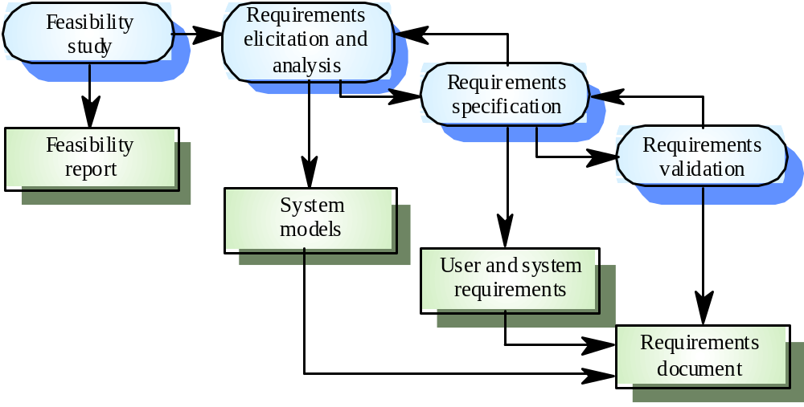
The requirements engineering process

Slide 63
Requirements Analysis Techniques
Interviewing
Structured versus unstructured interviews
Questionnaires
Forms Analysis
Video Camera
Rapid Prototyping
Scenarios
    Story boards

Slide 64
SPECIFICATION
In the context of computer-based systems (and software), the term specification means different things to different people. A specification can be a written document, a set of graphical model, a formal mathematical model, a collection of usage scenario, a prototype or any combination of these.

Slide 65
Qualities of a Specification
Implementation free –what is needed, not how it is achieved
Complete – there is nothing missing
Consistent – no individual requirements contradicts another
Unambiguous –each requirements has a single interpretation
Concise – each requirement is stated once only, without duplication

Slide 66
Qualities of a Specification(Cont..)
Minimal – there are no unnecessary ingredient
Understandable-by both the client and the developer
Achievable – the requirements is technically feasible
Testable – it can be demonstrated that the requirements have been meant

Slide 67
REQUIREMENTS SPECIFICATION DOCUMENT
The end product of requirements elicitation and analysis is the requirements specification. The specification is the reference document against which all subsequent development is assessed. The specification documents is structured as follow:

Slide 68
Functional Requirements
Functional requirements specify what the system should do. Examples are:
Calculate the compound interest at the rate of 14% per annum on a fixed deposit for a period of three years
Calculate subscriber’s bill as charge per minute multiplied by call time
Invert a square matrix of real numbers (maximum size 100 X 100)

Slide 69
Data Requirements
Users’ data that is input to or output from the system via screen, keyboard or mouse
Data that is stored within the system, usually in files on disks, for example, information about subscribers held in a service provider’s server
Information passed to or from another computer system, for example, to a server

Slide 70
Performance Requirements
These are measure of performance, some of which are quantitative, and some of which can used as part of testing. E.g
Cost
Delivery Date
Testing times (e.g. the system will respond to user request within one second.)

Slide 71
Performance Requirements
Data volumes (e.g the system must be able to store information on 10,000 subscribers)
Loading level to be coped with (e.g the system must be able to cope with 100 transactions per minute from the point-of-sale terminals)
Reliability requirements (e.g the system must have a mean time between failure of six months)

Slide 72
Performance Requiremenst
Security Requirements (e.g only authorized persons should have access to the system)

Slide 73
Constraints
These are influences on the implementation of a system. An example is : The system must be written in Java
Constraints deal with such items as:

Slide 74
Examples of constraints
The computer hardware that is to be used
The amount of memory available
The amount of backing store available
The programming language to be used
Interoperability constraint (e.g the software must run under the latest version of windows)

Slide 75
Contraints often address implementation (e.g the specification of the programming language ) and therefore should be included with caution. For example, this might be unnecessary constraining:
The search must use binary chop method

Slide 76
Guidelines
A guideline provides useful direction for the implementation in a situation where there may be more than one implementation strategy: For example:
The response time of the system to mouse click should be minimized
As an alternative – The usage of main main memory should be as small as possible

Slide 77
Many specifications mix up the areas identified above, so that, for example, design guidelines are sometimes confused with functional requirements

Slide 78
Use Cases
One widely used approach to documenting requirements is “use cases”. These are textual description which can be augmented by UML use case diagrams. Use case take the point of view of the users of the system.. A user who is carrying out a particular role is called an actor
A use case is a task that an actor needs the system to carry out.

Slide 79
Examples of Uses Cases in an ATM Machine
Withdraw Cash
Check Balance
Transfer Money
A use case both specifies what the user does and what the system does, but says nothing about how the system performs its task. In an ATM system, the use case for withdrawing cash is

Slide 80
Cash Withdrawal
The user offers up their card. The system prompt for the PIN. The user enters the PIN. The system checks the PIN. If the card and PIN are valid, the system prompts the user for their choice of function. The user selects cash. The user prompts for the amount. The user enters the amount. The system ejects the card. When the user has withdrawn the card, the system dispense the cash

Slide 81
Use Case Diagram
Use case diagram is an informal graphical representation of requirements. In the diagram, there is a single actor, shown as a stick figure. The name of the role of the user is shown below. Arrows lead from the actor to the use cases, shown as oval with function name beneath. Notice that a use case diagram does not contain the detail associated wit textual use case. However, it does give an overall picture of the actors and the use cases.

Slide 82
SOFTWARE MODELLING AND DESIGN
Software Design comes after software requirements and before implementation
The Unified Modelling Language (UML) can be used for modelling abd design of software
UML is a visula language that can be used in developing software systems
At the centre of the UML are nine kinds of modelling diagrams

Slide 83
UML Diagrams
Use case diagrams
Class diagrams
Object diagrams
Sequence diagram
Collaboration diagrams
Activity diagrams
Component diagrams
Deployment diagrams

